Slide 1


Gun Violence
What’s going on in Chicago?
By: Jasmine Williams, Data Analyst

Slide 2
Gun Violence Facts
Firearm related deaths in the U.S. are 26 times higher than other industrialized nations
Firearm related deaths are now the third leading cause of death among children in the U.S. (aged 1 to 17)
60% of firearm homicide victims in the U.S. are Black Americans
There were 346 mass shootings in the U.S. in 2017

Slide 3
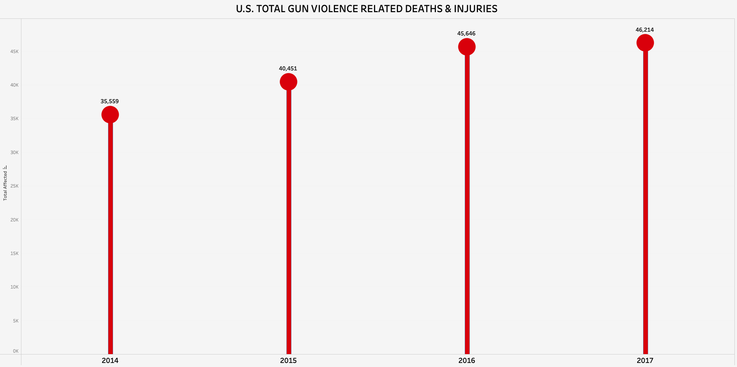
Gun violence in the u.s.

Slide 4
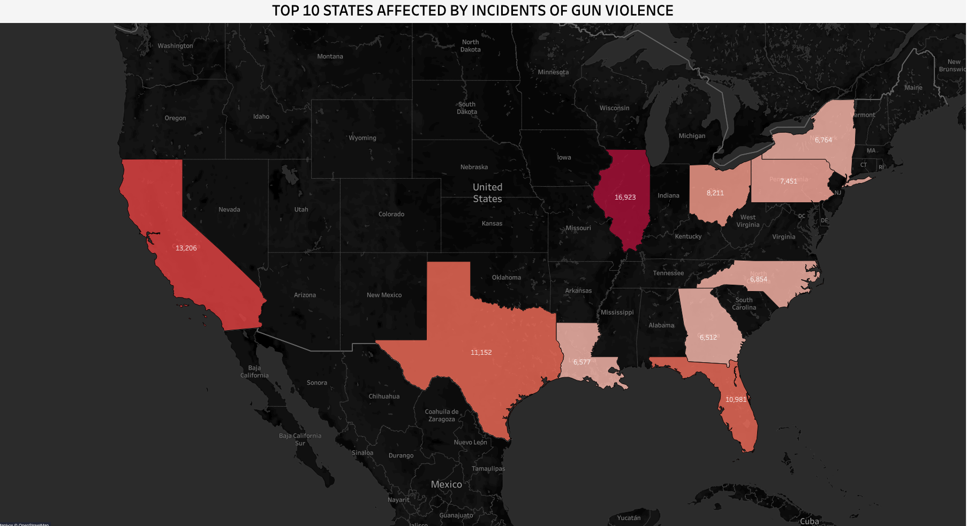
Where is this happening?
After Illinois, California, Texas, Florida and Ohio account for high rates of gun violence incidents
New York is in the top 10

Slide 5
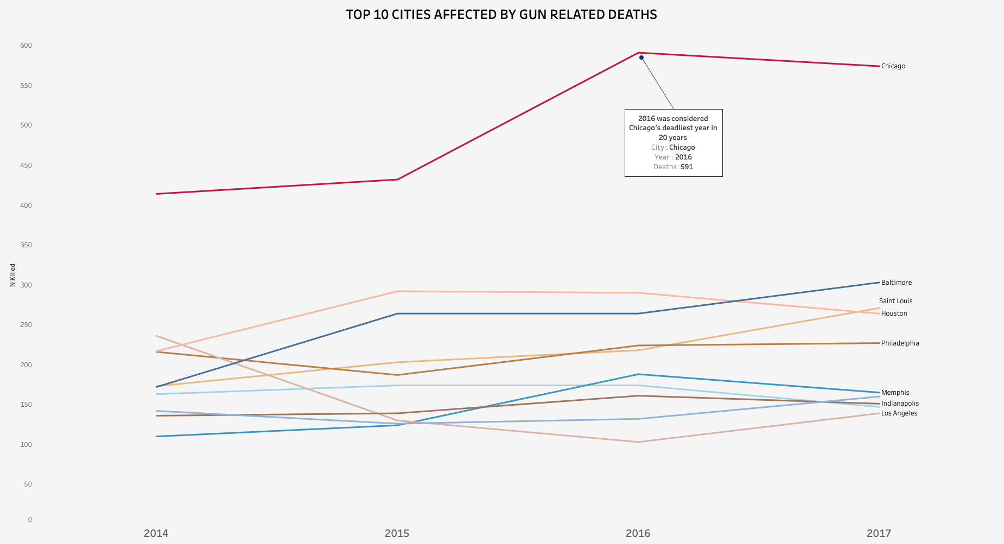
What’s going on in major cities?
Chicago in 2016 was the topic of many political debates during the election
There are many theories about why this increase in gun violence happened

Slide 6
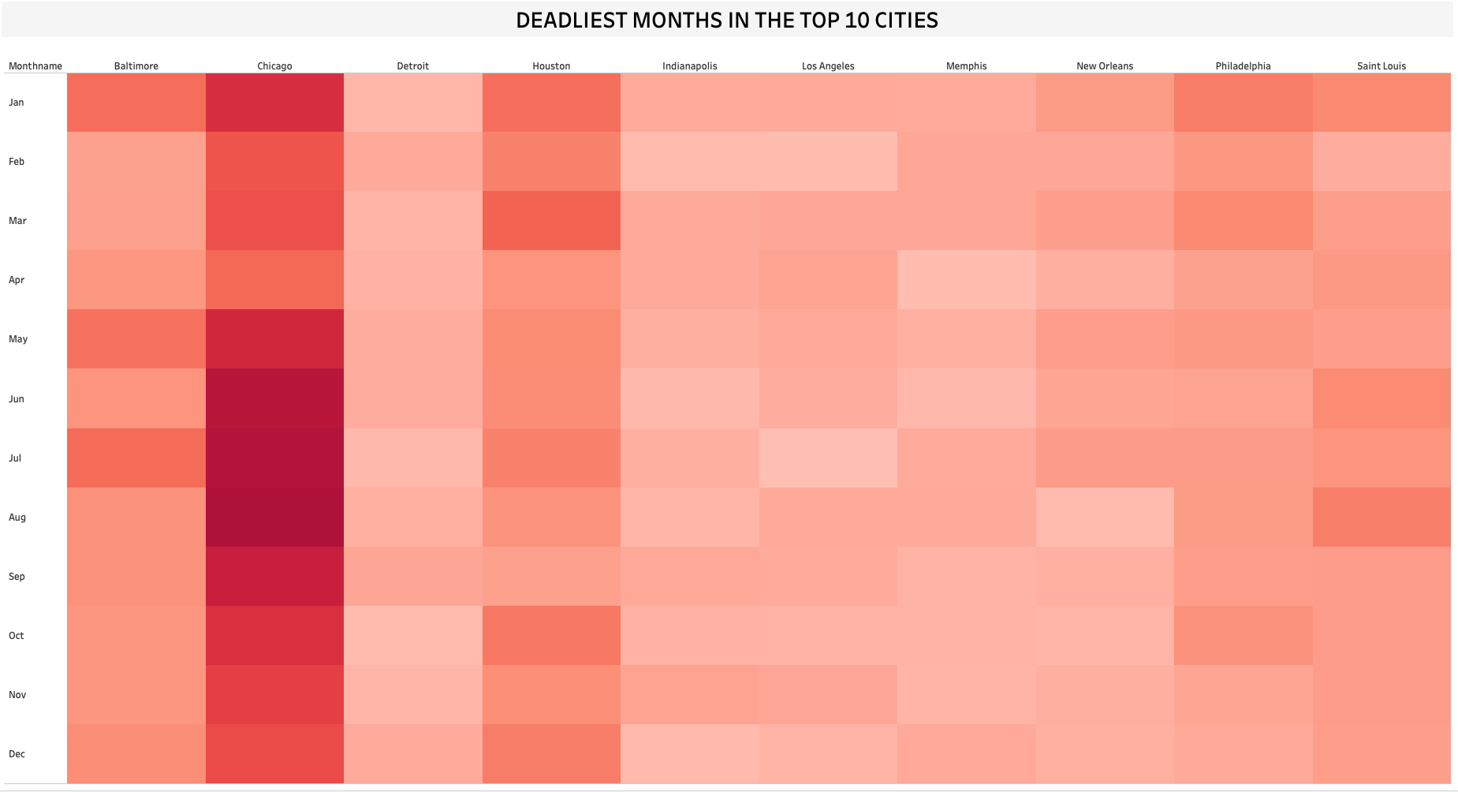
When is this happening?
Hotter weather leads to people spending more time outside
More Social interaction
Less summer programs in under-resourced communities

Slide 7
Factors that contribute to gun violence
Easy access to firearms by high-risk people (Gun-Law effects)

Slide 8
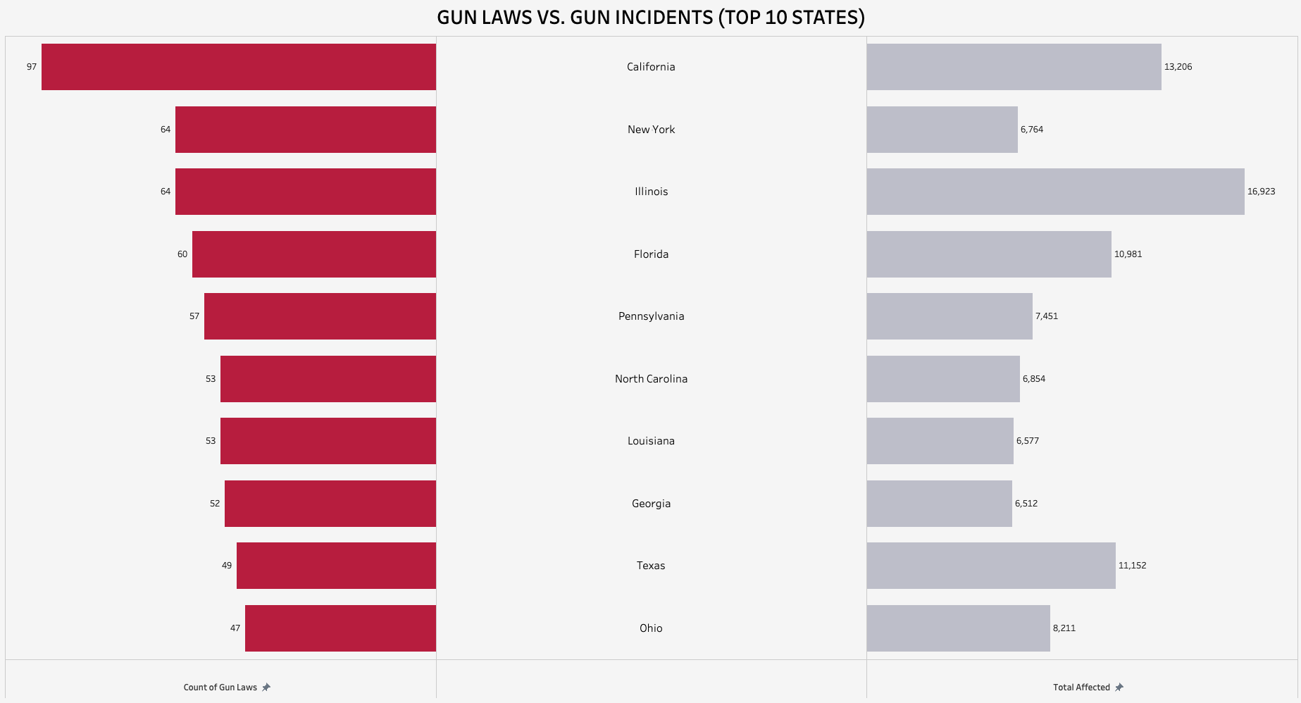
Gun Laws and their impact
California takes the lead with the most amount of gun laws
Illinois ties with New York for amount of gun laws

Slide 9
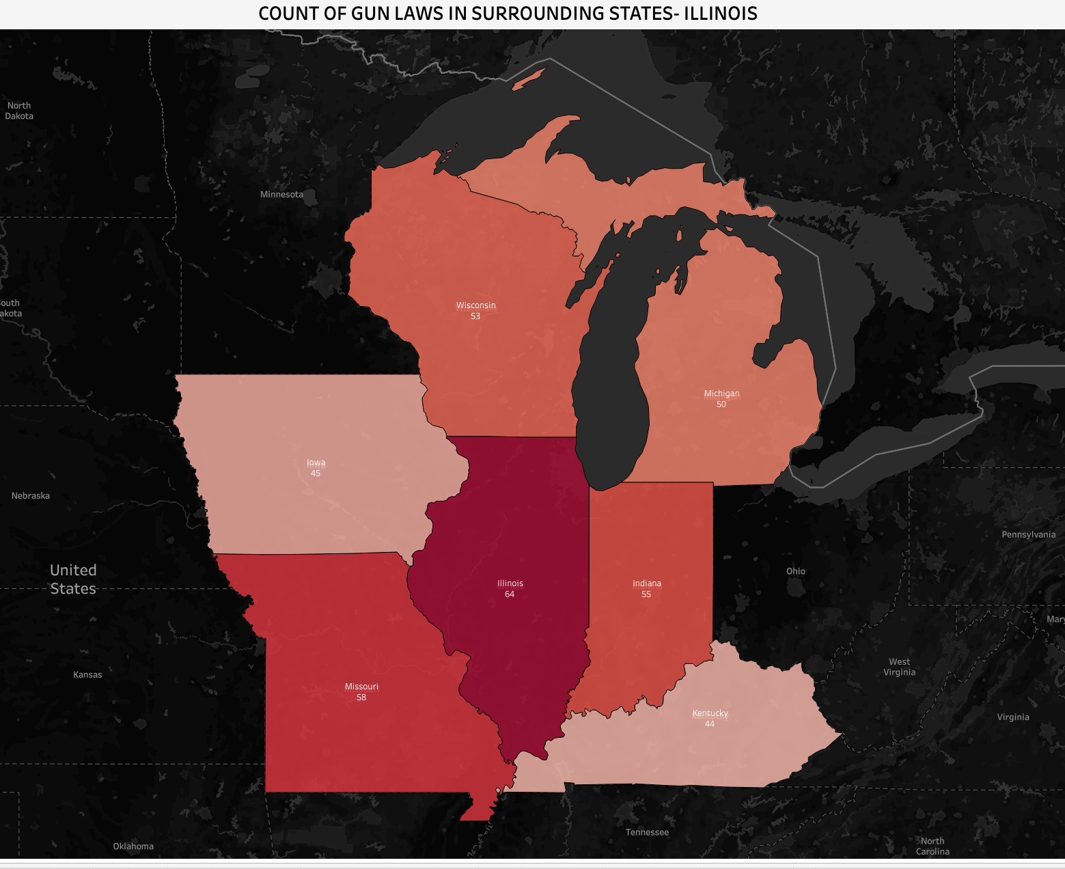
Gun Trafficking
According to police and researchers, many guns are coming in from surrounding states
Chicago’s 2017-gun trace report confirmed this when they unveiled that 60% of recovered firearms came from out of state, mostly Indiana

Slide 10
Factors that contribute to gun violence
Easy access to firearms by high-risk people (Gun-Law effects)
Poverty, Unemployment rate, Education (Economic Hardship Index)

Slide 11
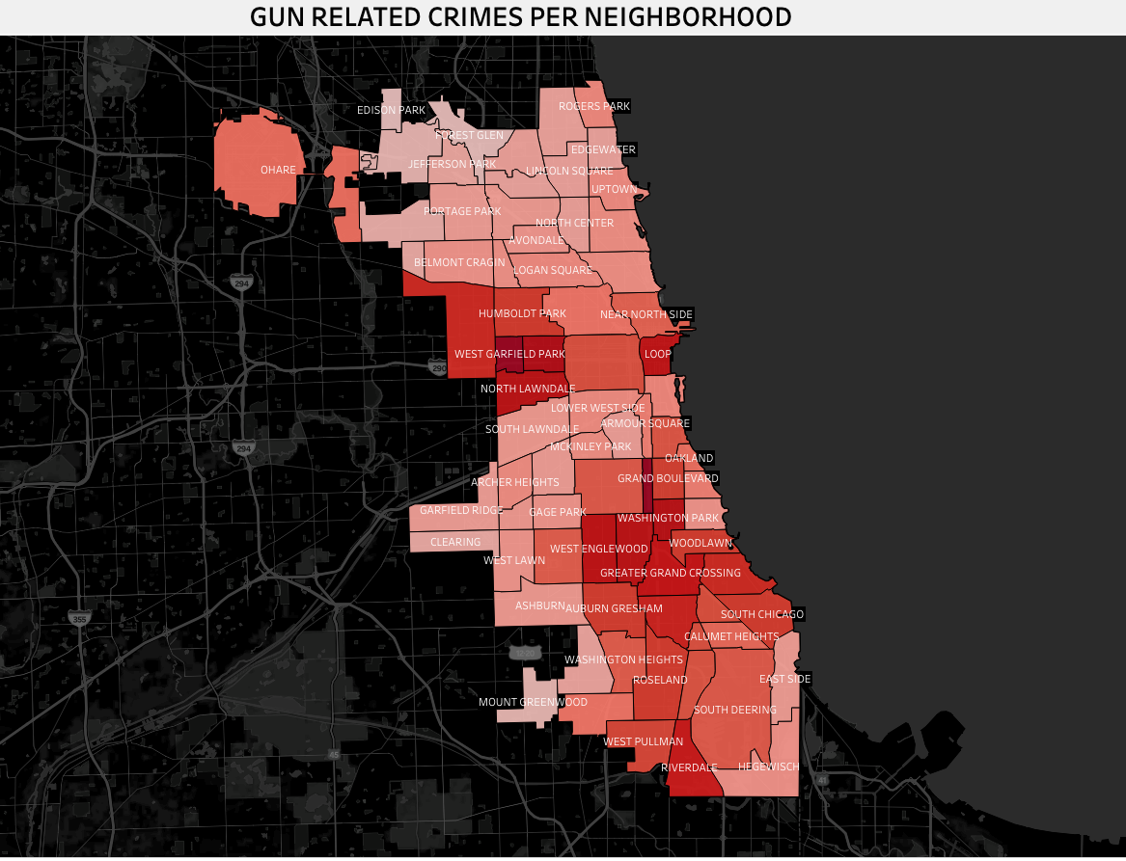
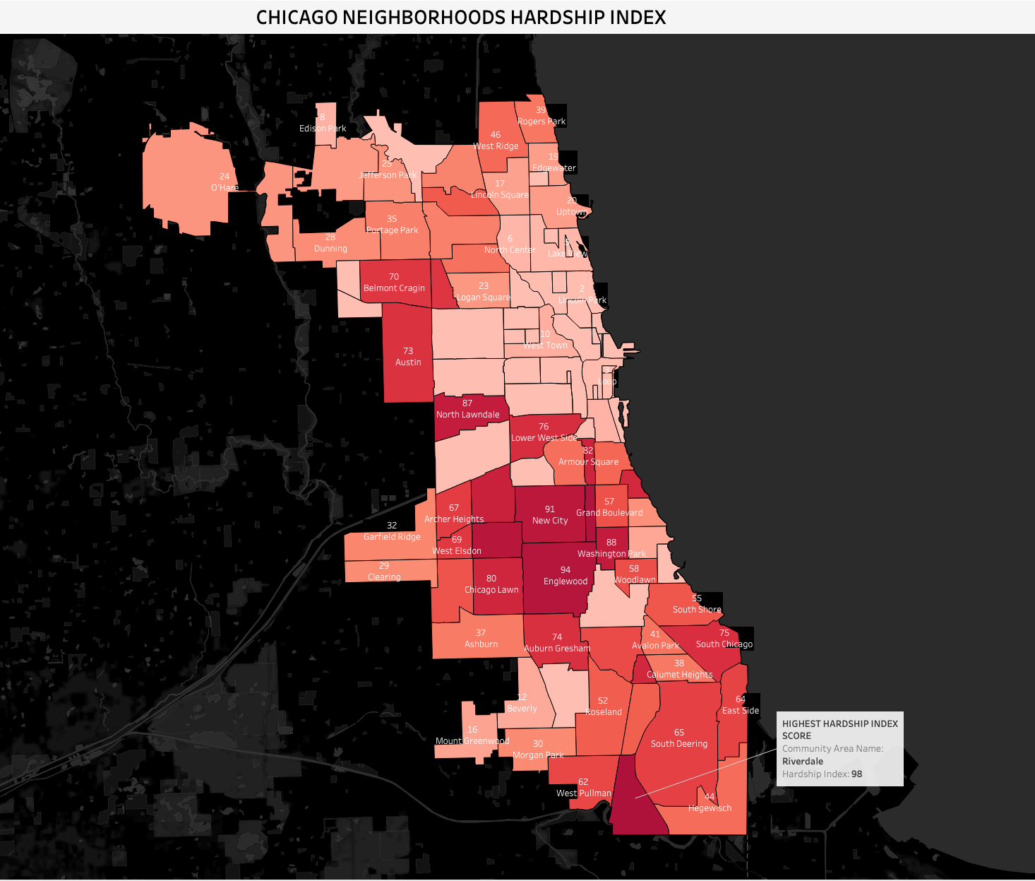
Socioeconomic impact

Slide 12
Conclusion
Gun Violence is a multi-dimensional issue
There are many underlying causes
Chicago’s Mayor (Mayor Lightfoot) released a comprehensive plan to reduce gun violence in 2020
In 2021, Chicago PD superintendent, David Brown announced a new strategy to stop the flow of guns into the city.

Slide 13



information
Resources
https://data.cityofchicago.org/Facilities-Geographic-Boundaries/Boundaries-Neighborhoods/bbvz-uum9
https://www.chicago.gov/content/dam/city/sites/public-safety-and-violenc-reduction/pdfs/OurCityOurSafety.pdf
https://www.chicago.gov/content/dam/city/depts/mayor/Press%20Room/Press%20Releases/2017/October/GTR2017.pdf
https://abcnews.go.com/US/chicago-unveils-gun-violence-plan-violent-weekend/story?id=78924413
https://everytownresearch.org/report/gun-violence-in-america/
Data Used
Gun Violence Data: https://www.kaggle.com/datasets/jameslko/gun-violence-data
State Gun Laws: https://www.rand.org/pubs/tools/TLA243-2-v2.html
Chicago Hardship Index: https://data.cityofchicago.org/Health-Human-Services/Unemployment/ymyn-s5a8
Tools and programming languages used:

Slide 14

CONNECT WITH me
Jasmine Williams
Email: Jasmine.s.williams1@gmail.com
LinkedIn: https://www.linkedin.com/in/jasminewilliams1111/
Tableau Public: https://public.tableau.com/app/profile/jasmine.williams4654#!/

Slide 15


Thank YOU

